Slide 1
QMS Training
Overview of Software Engineering Concepts &
Process Model for Oracle Group
Version No 2.0
Training Module-
Quality management Group

Slide 2

Agenda
Introduction
to
Software Engineering
What is SW Engineering ?
Why SW Engineering ?
Software Process Models
Process Model for Oracle Group

Slide 3




Evolution of Software Engineering
MAGIC
Only few
ART
Few more ...
All of us
SCIENCE
The word Software Engineering was coined in about 1969

Slide 4
The definitions..
Software Engineering is the establishment and use of sound Engineering principles in order to obtain economically, software that is reliable and works efficiently on real machines
Fritz Bauer, Roger S. Pressman
Software Engineering is the application of a systematic, disciplined , quantifiable approach to the development, operation, and maintenance of software; that is , the application of engineering to software
IEEE definition

Slide 5
Software Engineering is a layered technology
Provide “how-to’s” for
the software development.
RA, design, coding, testing
and maintenance are part
of methods
Provide automated support to
process and methods. CASE, a
system for the support of SW
development
Tools
Commitment
to
Quality
Methods
Process
A Quality Focus
Foundation layer for software
engineering. Software Engineering
process is the glue that holds the
technology layers together

Slide 6
Generic View of Software Engineering
Definition
focuses on "What ?"
Requirement Gathering, Analysis
Development
focuses on "How ?"
Architecture, Design, Coding, Testing
Maintenance
focuses on "change"
Correction, Adaptation, Enhancement

Slide 7

Umbrella activities complementing SW Engg.
Project Planning, tracking and control
Reviews/Inspections
Quality Assurance
Configuration Management
Measurement
Risk Management
Quantitative Process Management

Slide 8

Myths
If we get behind the schedule, we can add more programmers and catch up
A general statement of objectives is sufficient to begin writing programs - we can fill the details later
Requirements are bound to change - but changes can be easily accommodated because software is flexible
Once we write the program and get it to work, our job is done
Until I get the program running, I really don’t have any means to assess quality
The only deliverable for a successful project is the working program
Notes:
Myths

Slide 9

Agenda
What is SW Engineering ?
Why SW Engineering ?
Software Process Models
Process Model for Oracle Group

Slide 10



The usual issues…
Inability to predict time, effort and cost
Poor Quality of Software
Reliability and maintainability were difficult
Delivered systems frequently did not work
Fixing bugs in delivered SW produced more
bugs
Notes:
1979 study of a small number of government projects showed that
2% worked
3% could work after some corrections
45% delivered but never successfully used
20% used but extensively reworked or abandoned
30% paid and undelivered

Slide 11

Ratio of HW/SW costs..
Changes in ratio of HW to SW costs
early 60’s - 80% hardware costs
middle 60’s - 50 to 60% hardware costs
today - less than 20% hardware costs

Slide 12
Maintenance costs are very high!!
Increasingly important role of maintenance
Fixing errors, modification, adding options
Cost is often twice that of developing the software

Slide 13
Application of SW.. Almost everywhere!
Increased demand for SW
Medicine
Manufacturing
Entertainment
Publishing

Slide 14
SW systems getting more complex!
Demand for larger and more complex SW systems
Airplanes
NASA
Life Support Systems
ATMs
Car Systems, Missiles and so on
Notes:
Number of airplane crashes
Aborted space shuttle launches
“Ghost” trains, runaway missiles
Have you ever had your card “swallowed” ?
National Security and day to day operations are highly dependent on
computerized systems
Pervasiveness and invasiveness of computerized systems

Slide 15
Current Situation
High Costs for Software
Variation in software practices
Need for increased productivity
Need for “ilitys” (portability, maintainability, scalability, reliability and so on)

Slide 16
Agenda
What is SW Engineering ?
Why SW Engineering ?
Software Process Models
Process Model for Oracle Group

Slide 17
SW Process Models
A process model models desired phases or activities in a project
By following a pre-specified process, a project should increase the quality of its process:
  Repeatability
  Manageability
  Measurability
Interim work products are more clearly defined and justified
  Design documents and plans
Activities are less likely to be forgotten
Software Development encompasses process, methods and tools
Process model chosen based on:
  Nature of project and application
  Methods and tools to be used
  Controls and deliverables required

Slide 18

Software Lifecycle Models
Waterfall model
V-Shape model
Prototyping model
RAD (Rapid Application Devt.) model
Incremental model
Spiral model

Slide 19
Waterfall model
Most common and classic of life cycle models, also referred to as a linear-sequential life cycle model.
Each phase must be completed in its entirety before the next phase can begin.
At the phase end, a review is conducted to determine if the project is on the right path and whether or not to continue or discard the project.
Phases do not overlap in a waterfall model.
Feasibility /
Analysis
Design
Build / Code
Test
Deliver /
Support

Slide 20
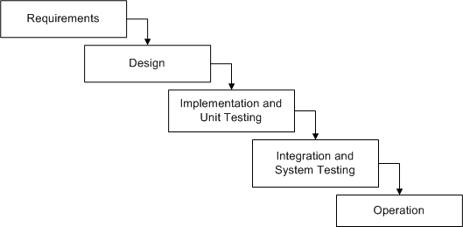
Waterfall model
Derived from other engineering processes in 1970
Expresses the interaction between subsequent phases
Each phase cascades into the next phase
Strict “sequence” was implied
No feedback between phases

Slide 21
Waterfall model
Limitations:
Real projects rarely follow the sequential flow
Often difficult for the customer to specify all the requirements upfront
Customer has to wait for long time before actually getting the “real deliverables”
Developers are often waiting for the phases to complete (because of the strict sequence)

Slide 22
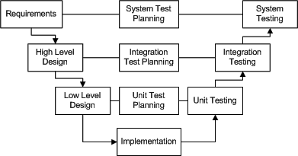
V-Shaped Model
V-Shaped life cycle is a sequential path of execution of processes. Each phase must be completed before the next phase begins. Testing is emphasized in this model more so than the waterfall model though.

Slide 23
V-Shaped Model
Simple and easy to use.
Each phase has specific deliverables.
Higher chance of success over the waterfall model due to the development of test plans early on during the life cycle.
Works well for small projects where requirements are easily understood.
Rigid, like the waterfall model.
Little flexibility and adjusting scope is difficult and expensive.
Software is developed during the implementation phase, so no early prototypes of the software are produced.
Model doesn’t provide a clear path for problems found during testing phases.

Slide 24
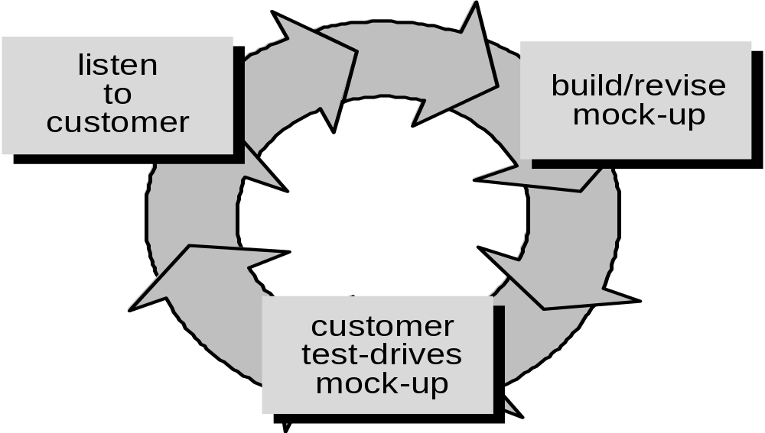
Prototyping Model
May be followed when customer defines a set of general objectives but no specifications of what he desires in terms of output requirements, processing, or inputs
Also used when the developer is unsure of the use of an algorithm, or the form of human-machine interaction, etc.

Slide 25
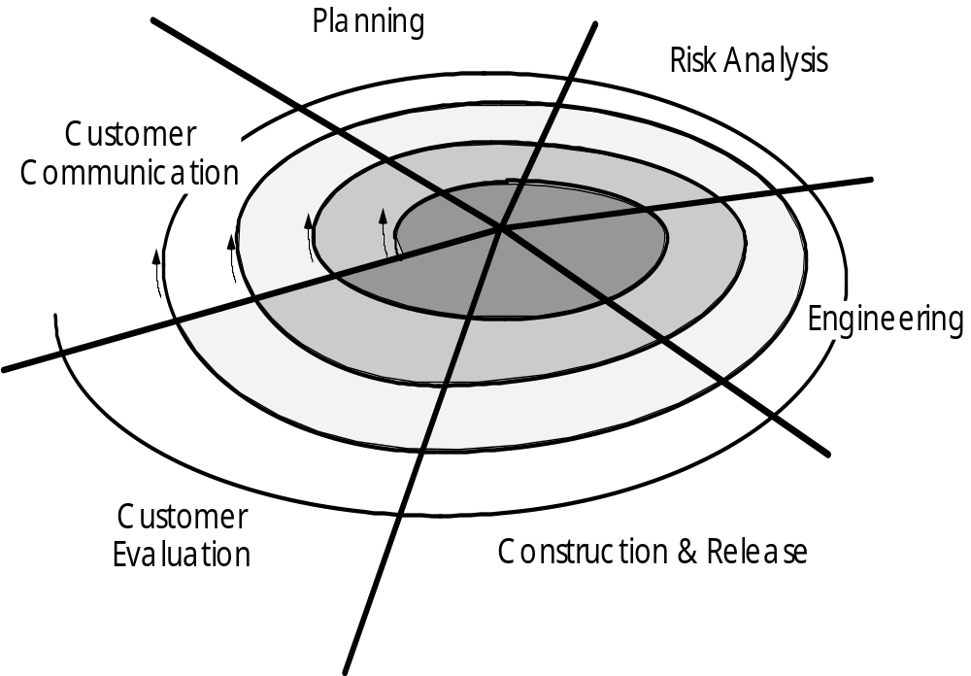
Prototyping Model

Slide 26
Prototyping Model
Serves as a mechanism to identify SW requirements
Aims to enhance the accuracy of designer’s perception of user’s requirements
Exploratory programming
Throw-away prototypes
Experiments showed that this approach took 40% less time (compared to Water Fall) and resulted in 45% less code
Requirements gathering
Developer – Customer meet to define overall objectives , identify whatever requirements are known, and outline areas where further definitions are mandatory
Quick design
Focusing on representing those aspects which will be visible to the customer (eg. Screens, output formats, etc.)

Slide 27
Prototyping Model
Limitations:
Difficult to convince customers for a “real product”
Implementation compromises might become integral part of the product
Documentation was often sacrificed
Schedule expectations of users and managers tended to be unrealistic

Slide 28
RAD Model
Emphasizes a short development cycle
“High Speed” adaptation of Linear Sequential Model
Rapid development achieved by using component based construction
Presumes clearly understood requirements and constrained project scope
Used primarily for information systems applications
Used primarily in information systems applications
Emphasizes extremely short development cycles
Components are built in a parallel fashion
Business modeling, Data modeling, Process modeling,
Application generation, Testing and turnover for each component

Slide 29
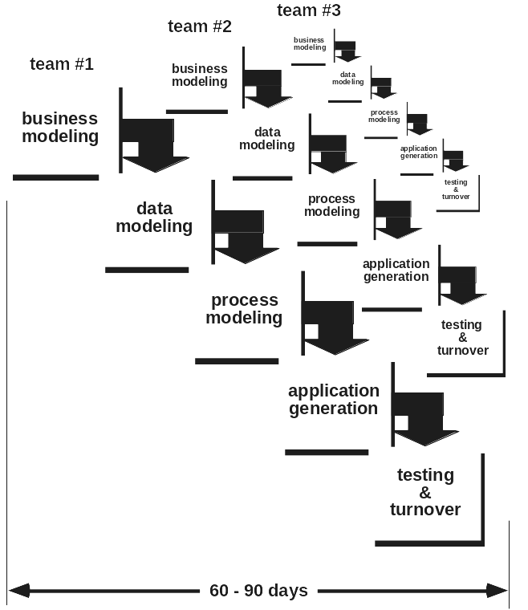
RAD Model

Slide 30
Incremental Model
Business Modeling
  Information flow among business functions
Data Modeling
  Set of data objects needed to support the business - derived from the information flow
  Characteristics (attributes) of each object identified and relationships defined
Core product is built first
“Supplementary Features” are delivered next
Every incremental release is usable, unlike in the prototyping model

Slide 31
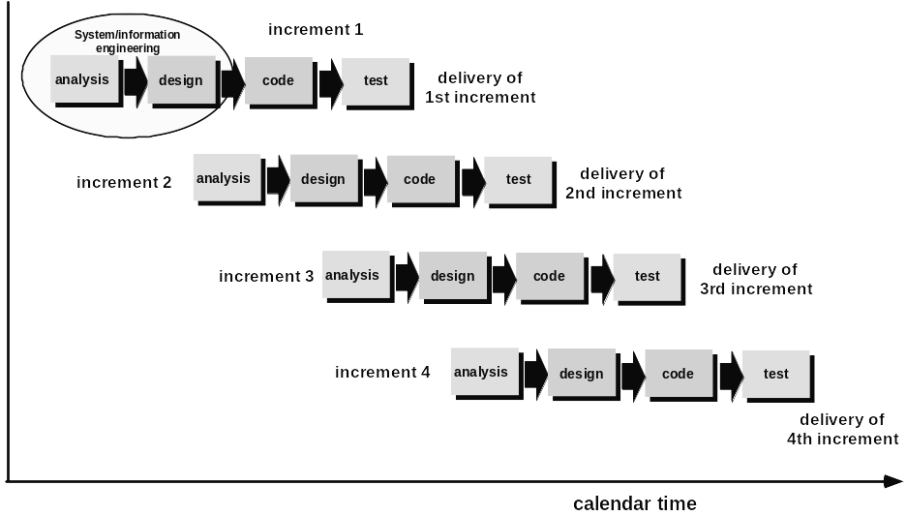
Incremental Model

Slide 32
Spiral Model
Combination of prototyping & waterfall models
Increased focus on risk analysis at each stage
(both technical and managerial risks)
Communication with the customer

Slide 33
Myths - “Demystified “!
If we get behind the schedule, we can add more programmers and catch up
“..adding people to a late project makes it later ….” Brooks
A general statement of objectives is sufficient to begin writing programs -
we can fill the details later
Poor up-front definition is the major cause of failed software efforts.
A thorough communication between the customer and the developer
leading to formal requirements specification is an absolute necessity
Requirements are bound to change - but changes can be easily accommodated
because software is flexible
Impact of change varies with time. If changes during the requirements
phase cost 1x, the changes during maintenance phase cost 60-100x.
Notes:
Myths

Slide 34
Myths - “Demystified “!
Once we write the program and get it to work, our job is done
“..the sooner you begin ‘writing code’ the longer it will take you to
get done …”
Until I get the program running, I really don’t have any means to assess quality
“..one of the most effective QA methods, formal reviews, applicable
at all stages in the life cycle..right from inception”
The only deliverable for a successful project is the working program
“A working program is only one part of software configuration
items…”
Notes:
Myths

Slide 35
Agenda
What is SW Engineering ?
Why SW Engineering ?
Software Process Models
Process Model for Oracle Group
Note : This model is yet to be formally frozen with US team though in principle accepted

Slide 36
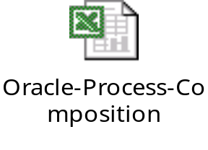
Proposed Process Model
Life-Cycle.
Deliverables
A suitable Life Cycle has been derived based on the brainstorming with most of the senior people here in India team
If implemented, it could best fit in our way of working with the dual Model framework.
It clearly depicts the phases involved in executing a typical oracle project.
A list of deliverables as expected from both the teams and the instance when these are expected also has been listed here.
Pictorial view of Process Model

Slide 37
Life-Cycle-Extended V Model for Projects
GA Log + Baselined SD
[US Team]
CRP1/CRP2 & UAT
Requirements
Acceptance Criteria
[Both are to be provided by US team parallelly and signed off by both teams]
System Testing
Design
Functional scenarios
[US Team]
[Both are to be provided by US team parallelly and signed off by both teams]
Baselined FD
[US Team]
Input
Offshore Testing
Baselined TD
[Ind Team]
Test Plan- Mdule+Functional
[To be prepared & Executed by India team and signed off by both teams]
Tested-Baselined Code +Test Results
To be provided by India team
Construction & Unit Testing

Slide 38
Deliverables Phase wise
Phase | Deliverable | Owner | By when | Sign off | Remarks
Reqmnts | 1.Provide the Gap Analysis Log & Baselined SD [LH side] 2.Provide the acceptance criteria [RH side] | US team | Before entering to Design Phase | Both teams | These are exclusively carried out by Onsite Team
Design | 1.Provide Baselined FD [LH side] 2.Provide Test Plan covering Functional Scenarios [RH side] | US team | Before entering TD phase | Both teams
Design | 1.Prepare TD [LH side] based on SD & FD 2.Prepare Offshore test Plan covering both module & functional Scenarios [RH side] | India Team | Before entering Construction Phase | Both teams | This is joint responsibility, if the Tech Lead from offshore is available at onsite
Construct on + UT | 1.Provide reviewed & unit tested code 2.Provide Test results + defects [RH side] | India Team | Before entering Module Testing Phase | India Team | These are exclusively carried out by offshore team
Legend
US Team
Jointly
India Team

Slide 39
Deliverables Phase wise
Phase | Deliverable | Owner | By when | Sign off | Remarks
Offshore Testing | 1.Provide reviewed & (module+functional) tested code[LH side] 2.Test results+defects [RH side] | India Team | Before entering to System Testing Phase | India Team | These are exclusively carried out by offshore team
System Testing | 1.Provide system tested code 2.Test results+defects | India Team with US team | Before entering to CRP1 Phase | Both teams | These are joint responsibilities between the 2 teams
CRP1/ CRP2 | Provide technical support for CRP1/CRP2 | India Team with US team | during the phase | Both teams
UAT | Provide technical support for UAT | India Team with US team | during the phase | Both teams
Go Live | Provide technical support for Go Live | India Team with US team | during the phase | Both teams
Legend
US Team
Jointly
India Team

Slide 40
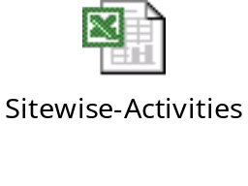
Site wise-Activities
It provides an elaborate view of the site wise activities
Based on our understanding of distribution of activities between US and India teams
Its has the elements like ‘inputs, outputs, feedbacks and possible roles at identified phase that needs to perform these tasks’
It also provides clear view of the dependencies of both these teams so that suitable management triggers, communication plans for resolving the same can be planned in advance by PMO personnel at US and Project Managers at India.
Pictorial view of site wise Activities

Slide 41

Project Documents & Records
Provides the list of set of documents/records that needs to be created/updated and maintained by both set of Project Managers US as well as in India.
If implemented in reality this provides the right set of documentation capturing all the essential information/data for any project.
It also serves as a repository for future leanings.
Pictorial view of Project documents & Records

Slide 42


This document has been prepared by TRIANZ
Reproduction and/or distribution without permission of TRIANZ is prohibited.

